Slide 1
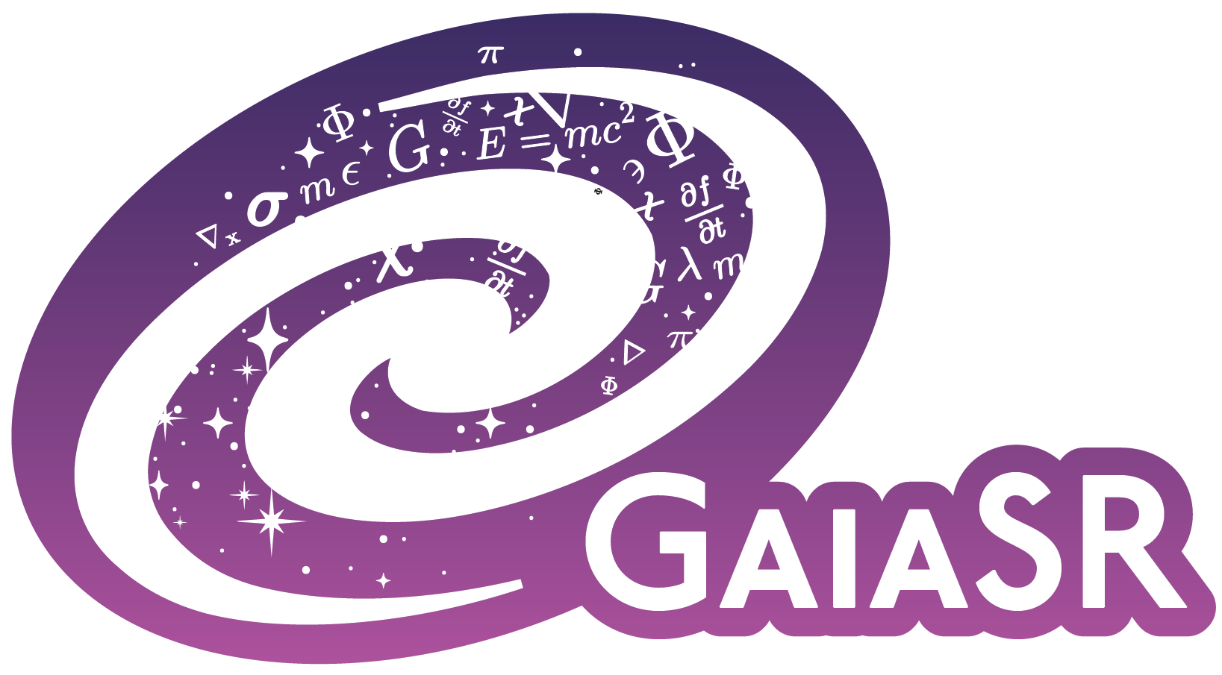
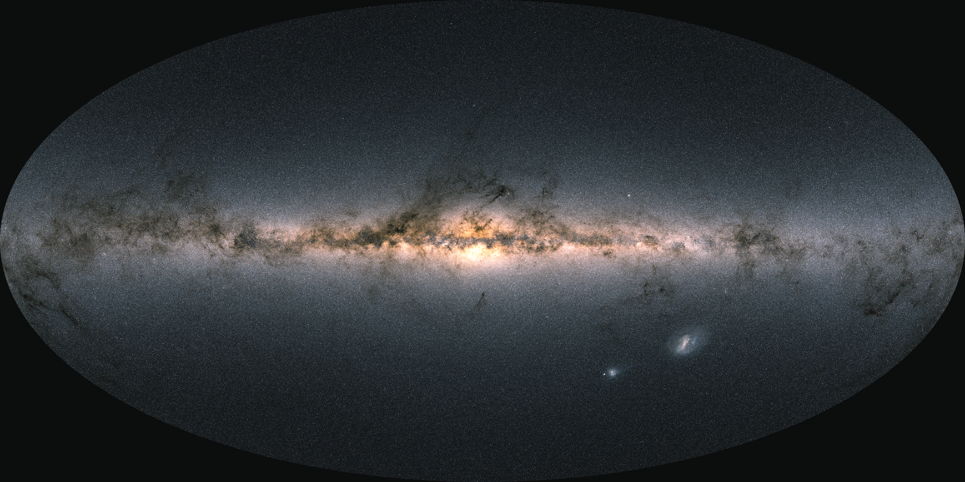
GaiaSR: Equation Hunting in Gaia
Can stars reveal the Milky Way’s gravity?
Gaia DR3 · 9.9 million nearby stars · two unknown functions
Team: Indranil, Akshay Ghalsasi, Adam Kamoski, Dora Demiri, Hanieh Karimi, Brianna Isola, Lucas
Notes:
The question behind this hackathon is simple to state: can the motions of nearby stars reveal the gravity of the Milky Way? We used about 9.9 million Gaia stars and searched for two compact equations—one for where the stars are in phase space, and one for the gravitational potential.
[Sources]
- C:/Users/akamo/Downloads/report.pdf, Abstract and Sections 1–2
- https://doi.org/10.5281/zenodo.8088365

Slide 2
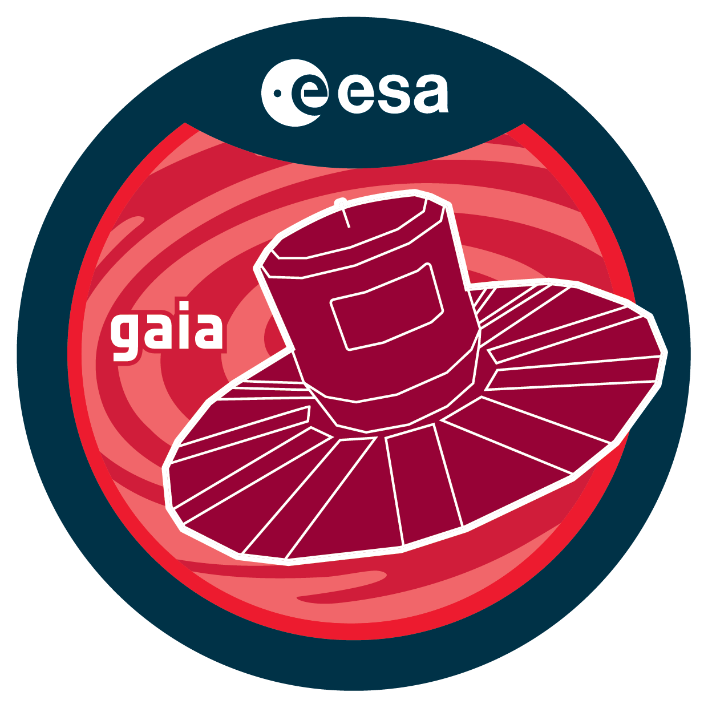
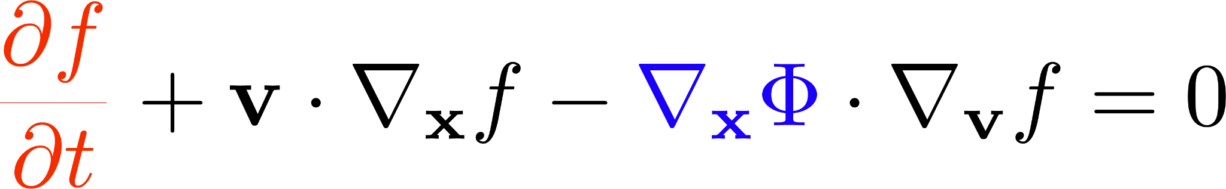
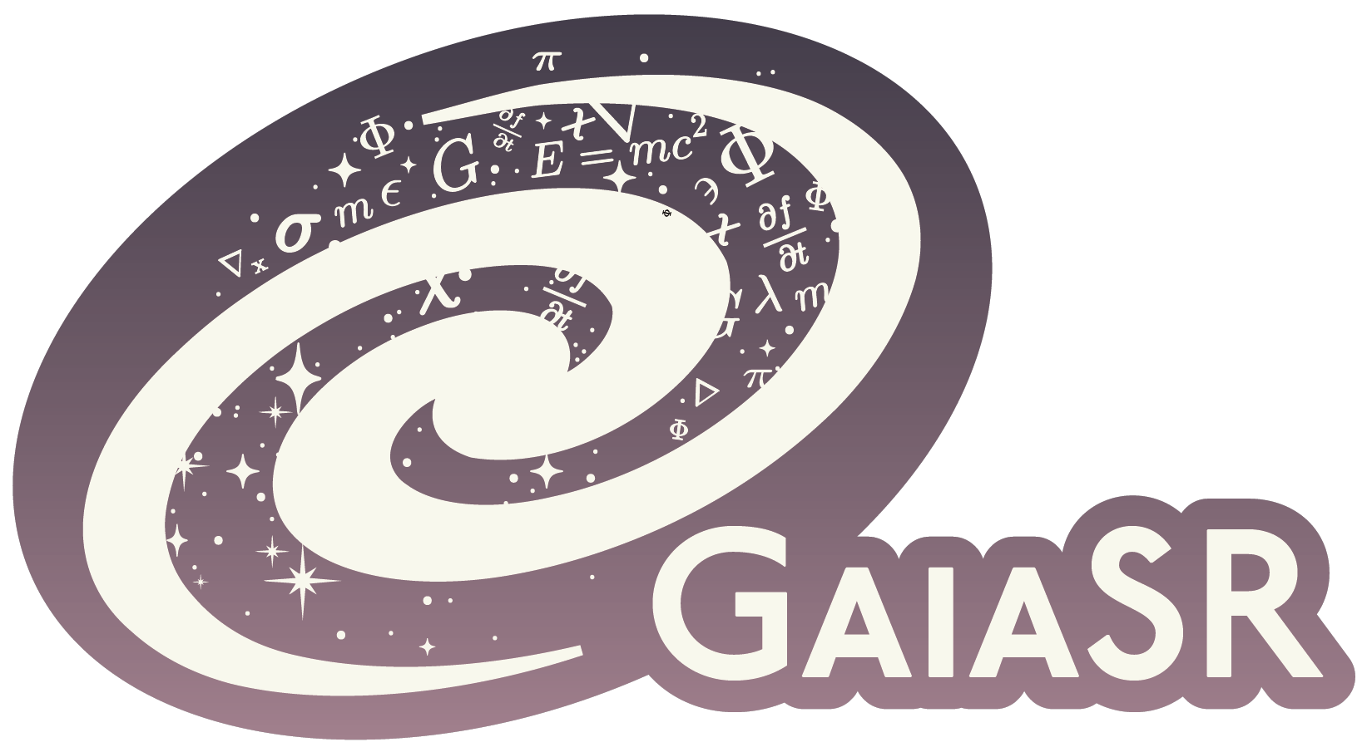
Stars carry a hidden map of gravity
Phase Space Density
Gravitational Potential
Notes:
Gaia gives us a snapshot: positions and velocities for millions of stars. Those stars sample a six-dimensional distribution function, f. What Gaia does not directly give us is the gravitational potential, Φ—the mass map that includes stars, gas, and dark matter. The acceleration of one star is much too small to measure over a human lifetime.
The bridge between the visible motion and the invisible gravity is the collisionless Boltzmann equation. In an equilibrium galaxy, the way the stellar distribution changes across position is balanced by the acceleration acting across velocity. So the hackathon prompt is to search jointly for compact closed forms for f and Φ that make this residual small, while f still describes the stars we were given.
[Sources]
- C:/Users/akamo/Downloads/report.pdf, Sections 1–2
- https://github.com/munozariasjm/sr_hackathon_iaifi2026

Slide 3
Stars carry a hidden map of gravity
What Gaia gives us
Positions and velocities for 9.9 million nearby stars—a snapshot of how the Galaxy is moving.
What remains hidden
The gravitational potential Φ: the mass map, including dark matter. A single star accelerates far too slowly to measure directly.
GOAL: find compact equations for the stellar distribution f and the Galactic potential Φ.
Notes:
Gaia gives us a snapshot: positions and velocities for millions of stars. Those stars sample a six-dimensional distribution function, f. What Gaia does not directly give us is the gravitational potential, Φ—the mass map that includes stars, gas, and dark matter. The acceleration of one star is much too small to measure over a human lifetime.
The bridge between the visible motion and the invisible gravity is the collisionless Boltzmann equation. In an equilibrium galaxy, the way the stellar distribution changes across position is balanced by the acceleration acting across velocity. So the hackathon prompt is to search jointly for compact closed forms for f and Φ that make this residual small, while f still describes the stars we were given.
[Sources]
- C:/Users/akamo/Downloads/report.pdf, Sections 1–2
- https://github.com/munozariasjm/sr_hackathon_iaifi2026

Slide 4
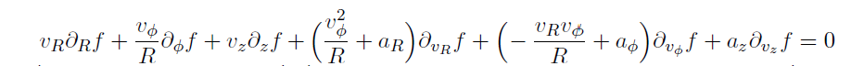

Coordinates and conventions
The galaxy is a disk: approximately symmetric about its rotation axis, and strongly flattened
Guarantees positivity
Removes the normalisation; Invariant under f --> cf
Removes the trivial solution f = 0
Notes:
Gaia gives us a snapshot: positions and velocities for millions of stars. Those stars sample a six-dimensional distribution function, f. What Gaia does not directly give us is the gravitational potential, Φ—the mass map that includes stars, gas, and dark matter. The acceleration of one star is much too small to measure over a human lifetime.
The bridge between the visible motion and the invisible gravity is the collisionless Boltzmann equation. In an equilibrium galaxy, the way the stellar distribution changes across position is balanced by the acceleration acting across velocity. So the hackathon prompt is to search jointly for compact closed forms for f and Φ that make this residual small, while f still describes the stars we were given.
[Sources]
- C:/Users/akamo/Downloads/report.pdf, Sections 1–2
- https://github.com/munozariasjm/sr_hackathon_iaifi2026

Slide 5
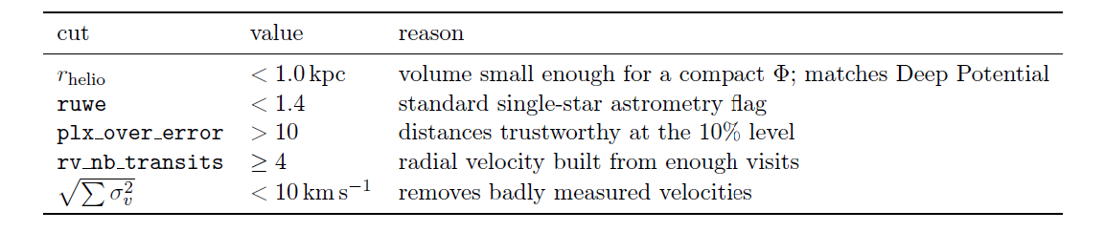


Selection cuts
A self-gravitating isothermal sheet has
Initial: 3x10^7
After cut: 10^7
Train/validation/test split: 70/15/15
Notes:
Gaia gives us a snapshot: positions and velocities for millions of stars. Those stars sample a six-dimensional distribution function, f. What Gaia does not directly give us is the gravitational potential, Φ—the mass map that includes stars, gas, and dark matter. The acceleration of one star is much too small to measure over a human lifetime.
The bridge between the visible motion and the invisible gravity is the collisionless Boltzmann equation. In an equilibrium galaxy, the way the stellar distribution changes across position is balanced by the acceleration acting across velocity. So the hackathon prompt is to search jointly for compact closed forms for f and Φ that make this residual small, while f still describes the stars we were given.
[Sources]
- C:/Users/akamo/Downloads/report.pdf, Sections 1–2
- https://github.com/munozariasjm/sr_hackathon_iaifi2026

Slide 6
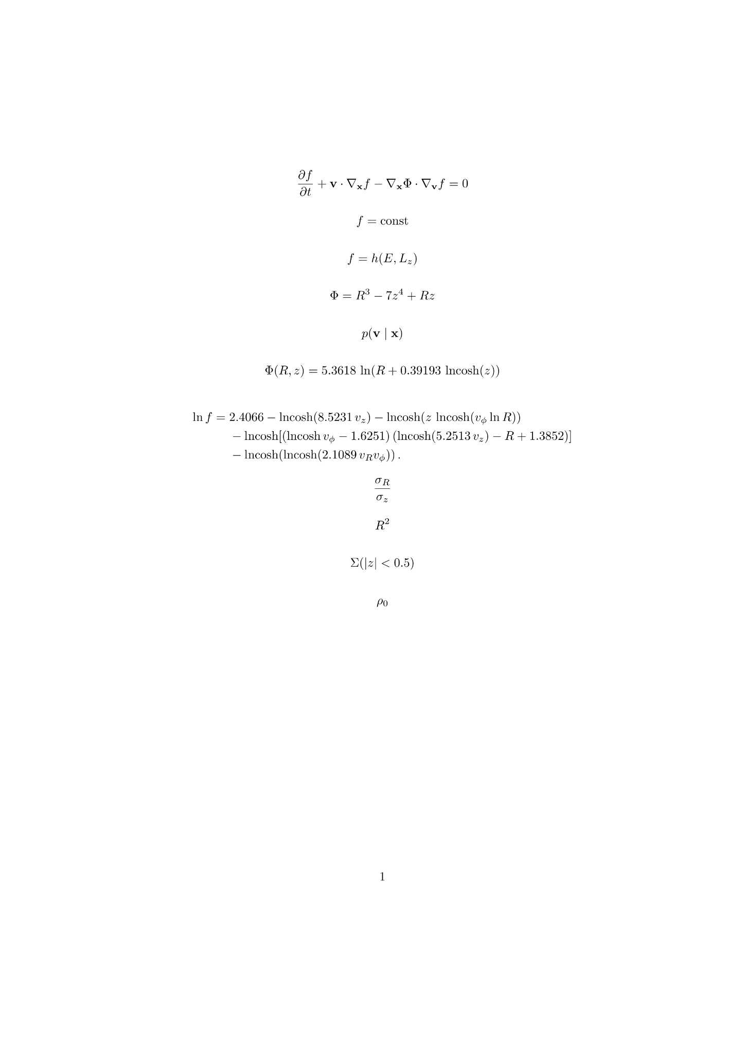
A perfect residual can describe nothing
The equation only sees derivatives of ln(f). An empty model can therefore score perfectly without learning the Galaxy.
1
All derivatives disappear. Loss = 0, regardless of the potential.
Φ with no z-dependence
2
No vertical force, so no disc (but the equation can still vanish).
— Jeans
3
Exact integrals cancel algebraically before any star is examined —> No variable separable solution
Even an absurd potential can score ≈ 0. With Φ = R³ − 7z⁴ + Rz, the residual is 5.3 × 10⁻¹¹ while individual terms are ~10⁵.
Notes:
The first thing we found was a trap in that objective. Every term contains a derivative of log f. If f is constant, every derivative is zero, so the residual is exactly zero for any potential. A model with no vertical structure can also score perfectly, even though it describes no Galactic disc. And if f is written only as a function of exact integrals of motion, the cancellation happens algebraically before a single star is evaluated.
We stress-tested this with a deliberately absurd potential: R cubed minus seven z to the fourth plus R z. The relative residual was five times ten to the minus eleven, while the individual terms were around one hundred thousand. Nothing physical was small; the terms were simply cancelling. That changed our motivation: the goal is not the smallest possible residual. It is the smallest residual among models that actually describe the stars.
[Sources]
- C:/Users/akamo/Downloads/report.pdf, Sections 3.1–3.3

Slide 7



The stars rule out the easiest exact solution
In any , radial and vertical velocities enter energy symmetrically.
That forces , independent of the fitted potential.
|z| [kpc] | σ_R | σ_z | ratio
|z| < 0.1 | 35.2 | 18.2 | 1.93
0.2 – 0.4 | 40.5 | 22.1 | 1.83
0.4 – 0.7 | 44.8 | 25.6 | 1.75
The data are strongly anisotropic.
Near the midplane, , , not 1.
An exact two-integral solution cannot describe these stars.
A nonzero residual can be more physical than a perfect one.
We therefore track both equation residual and . A candidate near 1 has collapsed onto the degenerate family.
Notes:
The data give us a clean physical check. In any distribution of the form f of energy and angular momentum, radial and vertical velocity enter the energy in the same way. That symmetry forces the radial and vertical dispersions to be equal, whatever potential we fit.
But the Gaia stars are not equal in those directions. Near the midplane, the measured ratio is about 1.93. So the easiest exact solution is ruled out by the data. This is why we report the dispersion ratio next to the residual. A candidate near one has collapsed onto the degenerate two-integral family, however impressive its residual looks. In this problem, a small nonzero residual can be more physical than a perfect zero.
[Sources]
- C:/Users/akamo/Downloads/report.pdf, Sections 3.4–3.5

Slide 8
Measure the force first; fit equations second
We removed CBE residual from the training objective and use it only as a final diagnostic. That avoids rewarding empty solutions.
1
2
3
4
Correct survey bias
Learn the distribution
Measure acceleration
Distill closed forms
Model where Gaia sees stars. Otherwise selection creates a false spatial gradient.
Fit velocities conditional on position, so the selection factor cancels.
Use symbolic regression with positivity and curl-free structure built in.
Notes:
Our response was to separate measurement from symbolic search. First, we model the survey selection, because Gaia does not observe every location equally. Second, we fit the velocity distribution conditional on position. If selection depends only on position, it cancels from that conditional distribution.
Third, inside many small spatial cells, the Boltzmann equation is linear in the acceleration. Thousands of stars then give an overdetermined least-squares estimate of the local force, without choosing a potential formula. Finally, we use symbolic regression to distill that measured field into a compact potential and to fit a compact log distribution. Positivity of f and curl-freeness of the force are built into the representation. Only after training do we compute the CBE residual as a diagnostic.
[Sources]
- C:/Users/akamo/Downloads/report.pdf, Sections 4–6

Slide 9
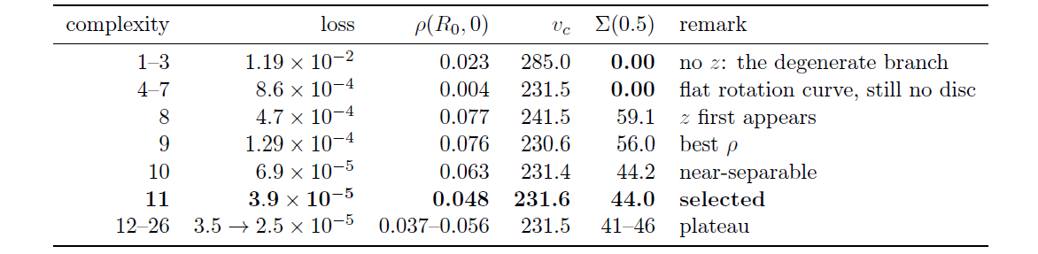
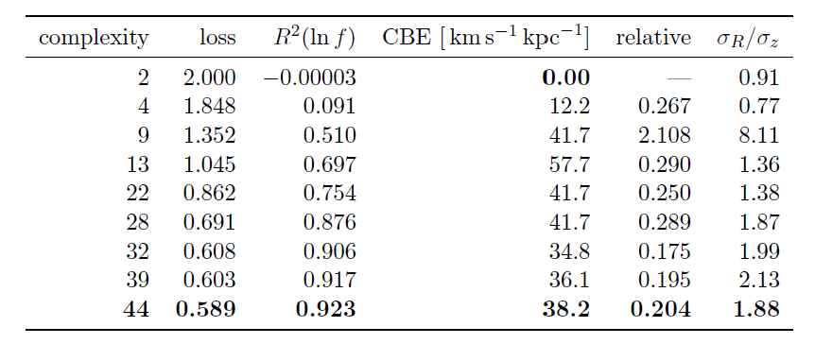

Slide 10

Two compact equations
Units: (100 km/s)², with R and z numerical in kpc. 11 nodes, 2 fitted constants.
Because R sits inside the logarithm, the potential is non-separable.
Velocities are numerical in units of 100 km/s. 44 nodes, 5 fitted constants. It matches σ_z (18.4 versus 18.2 km/s) and lets rotation set the disc thickness.
Interpret locally: positivity and Poisson density were enforced in the fitted box, but global normalizability and rotational asymmetry still need testing.
Notes:
These are the resulting closed forms. The potential is five point three six times the natural logarithm of R plus zero point three nine times log-cosh z. The parentheses matter: R is inside the logarithm, so this is not a separable radial-plus-vertical potential.
The distribution is more complicated, but still only forty-four nodes and five fitted constants; its velocities are numerical values in units of one hundred kilometres per second. Its first term gives a vertical velocity dispersion of 18.4 kilometres per second, compared with 18.2 in the data. Another term lets rotation control vertical thickness, which is the expected trend. We interpret both expressions locally. Positivity and a nonnegative Poisson density were checked in the fitted box, but global normalizability and the asymmetry of Galactic rotation still require work.
[Sources]
- C:/Users/akamo/Downloads/report.pdf, Sections 7–8 and displayed final equations

Slide 11
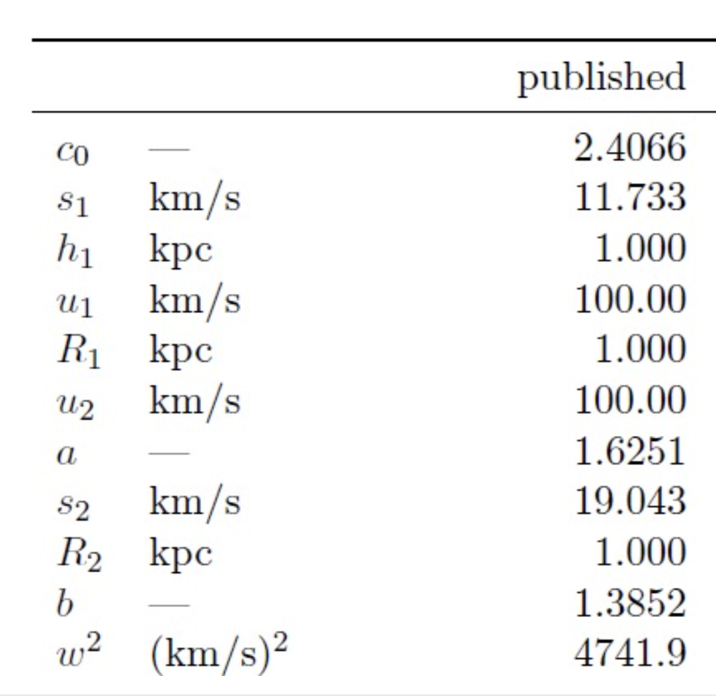
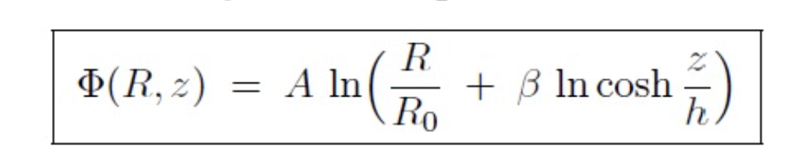
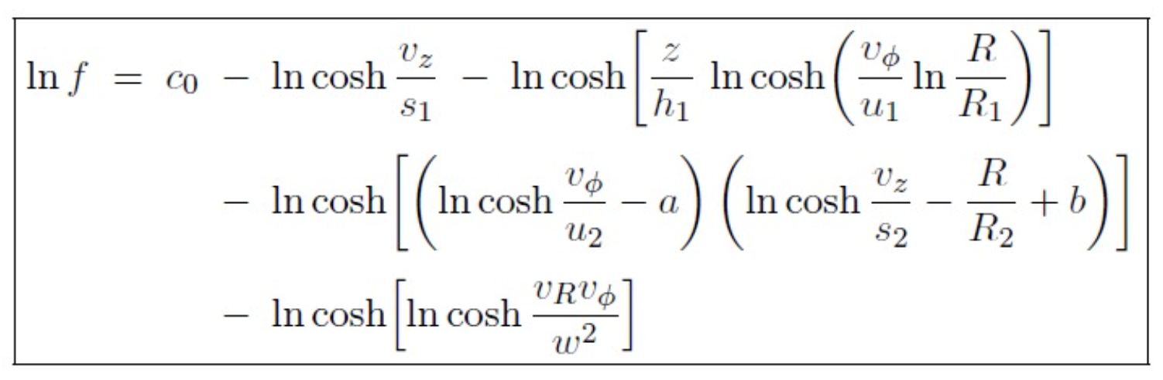
Putting in the dimensions
Notes:
These are the resulting closed forms. The potential is five point three six times the natural logarithm of R plus zero point three nine times log-cosh z. The parentheses matter: R is inside the logarithm, so this is not a separable radial-plus-vertical potential.
The distribution is more complicated, but still only forty-four nodes and five fitted constants; its velocities are numerical values in units of one hundred kilometres per second. Its first term gives a vertical velocity dispersion of 18.4 kilometres per second, compared with 18.2 in the data. Another term lets rotation control vertical thickness, which is the expected trend. We interpret both expressions locally. Positivity and a nonnegative Poisson density were checked in the fitted box, but global normalizability and the asymmetry of Galactic rotation still require work.
[Sources]
- C:/Users/akamo/Downloads/report.pdf, Sections 7–8 and displayed final equations

Slide 12
Useful predictions, with visible limits
0.204
1.88
0.923
relative CBE residual—95.8% of equation variance explained
radial/vertical dispersion ratio;
measured value 1.89
R² of ln f against the empirical density
independent check | ours | published
circular speed v_c | 231.6 km/s | 229 ± 3
radial gradient dv_c/dR | −1.1 km/s/kpc | −1.7 ± 0.1
disc surface density Σ(<0.5) | 44.0 M⊙/pc² | 42 ± 6
The zero-residual model loses
At complexity 2, g = constant gives residual 0.
But it has R² ≈ 0 and σ_R/σ_z = 0.91.
Our selected expression sacrifices a perfect residual to recover the observed distribution.
Held-out split spread is 0.5%; the main remaining mismatch is the low midplane density.
Notes:
On held-out stars, the selected model has a relative CBE residual of 0.204, explains about 92 percent of the empirical log density, and recovers a radial-to-vertical dispersion ratio of 1.883, close to the measured 1.893.
The comparison on the right is the key result. The constant model has exactly zero residual, but essentially zero density accuracy and a dispersion ratio of 0.91. Our selected expression deliberately accepts a nonzero residual to recover the observed structure. Train, validation, and test residuals differ by only about half a percent. The important caveat is that this is not a complete Galactic model: the inferred midplane density is low, and the equation still misses some measured force-gradient structure.
[Sources]
- C:/Users/akamo/Downloads/report.pdf, Sections 8–9 and held-out evaluation tables

Slide 13
Conclusion
1
Test the empty solution first
Before optimizing, ask what the cheapest degenerate model scores. A perfect empty baseline means the loss is wrong.
2
Build physics into the representation
Searching ln f guarantees positivity; fitting one shared Φ guarantees curl-freeness. Structural constraints cannot be violated.
3
Treat this as a local result, not the final Galaxy
Bottom line: compact local equations, an honest residual, and clear next experiments.
Notes:
Our main reflection is about objective design. First, always score the empty solution before launching a large search. If nothing scores perfectly, the loss is not enough. Second, physical structure is more reliable than penalties: searching log f guarantees positivity, and fitting one shared potential guarantees a curl-free force.
Third, this should be presented as a compact local model, not the final equation of the Milky Way. The midplane density is low, measured gradients are only partly recovered, and global distribution-function checks remain. Our next experiment is a matched benchmark against the other hackathon pipelines, followed by a richer but still interpretable vertical scaling. The useful outcome is not a claim of having solved the Galaxy; it is a pair of testable equations and a clearer standard for what a physically meaningful symbolic solution must pass.
[Sources]
- C:/Users/akamo/Downloads/report.pdf, Sections 9–10

